Slide 1
AVERAGE

Slide 4
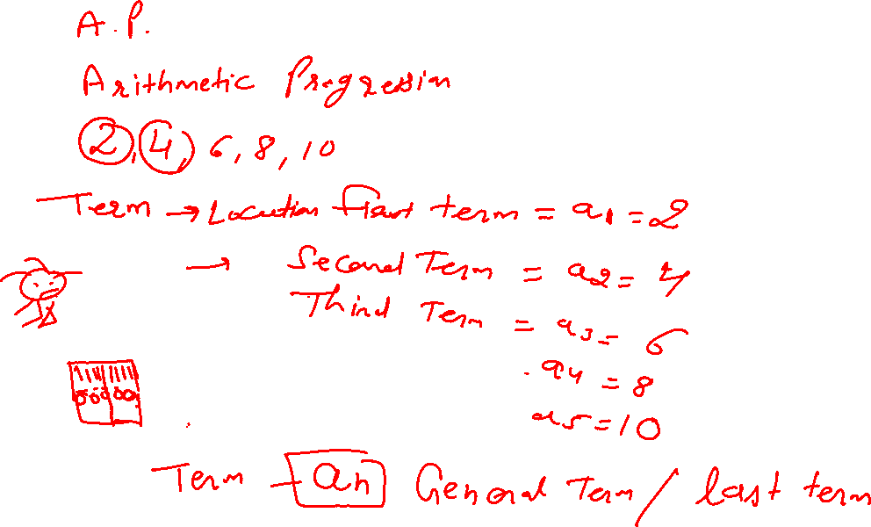

Slide 5
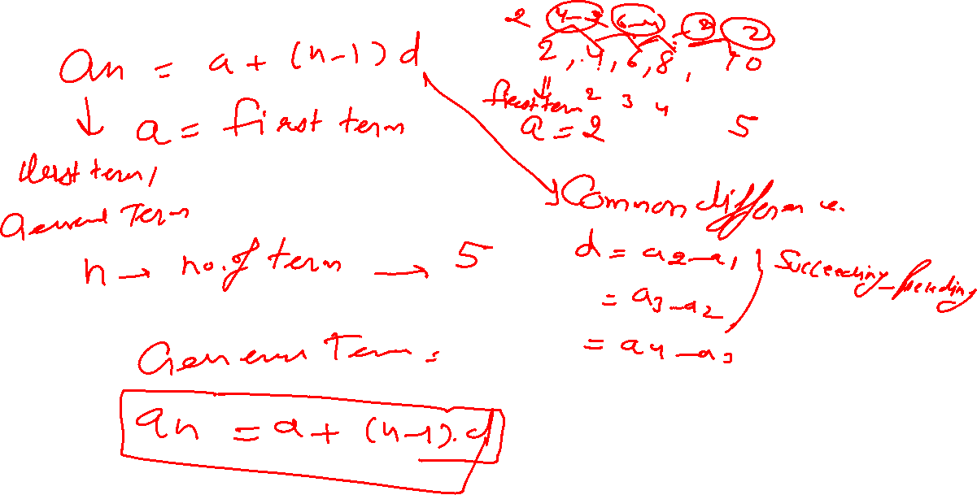

Slide 6
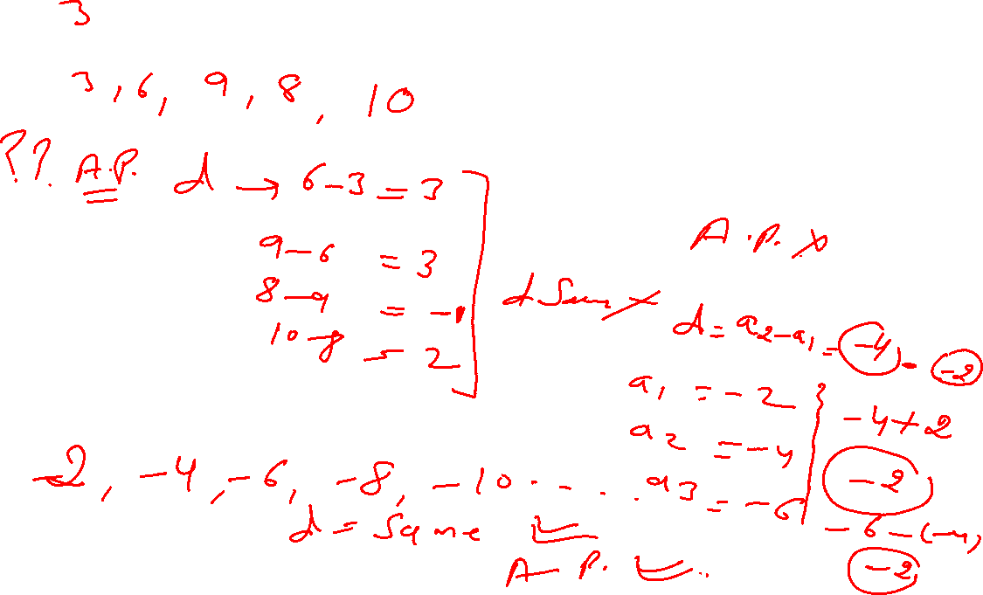

Slide 11
BASICS OF AVERAGES
Average This is the arithmetic mean, and is calculated by adding a group of numbers and then dividing by the count of those numbers. For example, the average of 2, 3, 3, 5, 7, and 10 is 30 divided by 6, which is 5. Median The middle number of a group of numbers.
Average = Sum of Values/Number of Values
Shortcut:·
Average of first ʻnʼ natural numbers =(n+1)/2
Average of first ʻnʼ even numbers = (n + 1)
Average of first ʻnʼ odd numbers = n

Slide 12
AVERAGES
Q 1. If a, b, c, d & e are five consecutive odd integers, what is their average?
a + 4
(2) (abcde)/5
(3) 5 (a + b + c + d + e)
(4) a + 8
(5) None of these

Slide 13
AVERAGES
Q 1. If a, b, c, d & e are five consecutive odd integers, what is their average?
a + 4
(2) (abcde)/5
(3) 5 (a + b + c + d + e)
(4) a + 8
(5) None of these

Slide 14
AVERAGES
Q 2. The average salary of 20 workers in an office is Rs1900 per month. If the manager’s salary is added, the average becomes Rs2000 per month. The manager’s annual salary (in Rs) is :
Rs4000
(2) Rs25200
(3) Rs48000
(4) Rs84000
(5) None of these

Slide 15
AVERAGES
Q 2. The average salary of 20 workers in an office is Rs1900 per month. If the manager’s salary is added, the average becomes Rs2000 per month. The manager’s annual salary (in Rs) is :
Rs4000
(2) Rs25200
(3) Rs48000
(4) Rs84000
(5) None of these

Slide 16
AVERAGES
Q 3. In a coconut grove, (x + 2) trees yield 60 nuts per year per tree, x trees yield 120 nuts per year per tree, and (x – 2) trees yield 180 nuts per year per tree. If the average yield per year per tree is 100, find x :
4
(2) 2
(3) 8
(4) 6
(5) None of these

Slide 17
AVERAGES
Q 3. In a coconut grove, (x + 2) trees yield 60 nuts per year per tree, x trees yield 120 nuts per year per tree, and (x – 2) trees yield 180 nuts per year per tree. If the average yield per year per tree is 100, find x :
4
(2) 2
(3) 8
(4) 6
(5) None of these

Slide 18
AVERAGES
Q 4. In a certain primary school, there are 60 boys of 12 years of age each, 40 boys of 13 years of age each, 50 boys of age 14 each, and 50 boys of age 15 each. The average age (in years) of the total boys in the school is :
13.50
(2) 13
(3) 13.45
(4) 14
(5) None of these

Slide 19
AVERAGES
Q 4. In a certain primary school, there are 60 boys of 12 years of age each, 40 boys of 13 years of age each, 50 boys of age 14 each, and 50 boys of age 15 each. The average age (in years) of the total boys in the school is :
13.50
(2) 13
(3) 13.45
(4) 14
(5) None of these

Slide 20
AVERAGES
Q 5. The average age of 24 students and the class teacher is 16 years. If the class teacher’s age is excluded, the average reduces by 1 year. What is the age of the class teacher?
50 years
(2) 45 years
(3) 40 years
(4) Data inadequate
(5) None of these

Slide 21
AVERAGES
Q 5. The average age of 24 students and the class teacher is 16 years. If the class teacher’s age is excluded, the average reduces by 1 year. What is the age of the class teacher?
50 years
(2) 45 years
(3) 40 years
(4) Data inadequate
(5) None of these

Slide 22
AVERAGES
Q 6. The average of 8 numbers is 14. If 2 is subtracted from each given number, what will be the new average?
12
(2) 10
(3) 16
(4) 18
(5) None of these

Slide 23
AVERAGES
Q 6. The average of 8 numbers is 14. If 2 is subtracted from each given number, what will be the new average?
(1) 12
(2) 10
(3) 16
(4) 18
(5) None of these

Slide 24
AVERAGES
Q 7. The average of x numbers is 3x. If (x–1) is subtracted from each given number, what will be the new average?
(1) 2x + 1
(2) (x – 1)3
(3) 2x – 1
(4) Data inadequate
(5) None of these

Slide 25
AVERAGES
Q 7. The average of x numbers is 3x. If (x–1) is subtracted from each given number, what will be the new average?
(1) 2x + 1
(2) (x – 1)3
(3) 2x – 1
(4) Data inadequate
(5) None of these

Slide 26
AVERAGES
Q 8. The average age of 34 boys in a class is 14 years. If the teacher’s age is included the average age of the boys and the teacher becomes 15 years. What is the teacher’s age?
48 years
(2) 46 years
(3) 49 years
(4) 45 years
(5) None of these

Slide 27
AVERAGES
Q 8. The average age of 34 boys in a class is 14 years. If the teacher’s age is included the average age of the boys and the teacher becomes 15 years. What is the teacher’s age?
48 years
(2) 46 years
(3) 49 years
(4) 45 years
(5) None of these

Slide 28
AVERAGES
Q 9. The average of 40 numbers is 405. If each of the numbers is divided by 15, find the average of the new set of numbers :
27
(2) 28
(3) 21
(4) 26
(5) None of these

Slide 29
AVERAGES
Q 9. The average of 40 numbers is 405. If each of the numbers is divided by 15, find the average of the new set of numbers :
(1) 27
(2) 28
(3) 21
(4) 26
(5) None of these

Slide 30
AVERAGES
Q 10. The average of 8 numbers is 21. If each of the numbers is multiplied by 8, find the average of the new set of numbers :
(1) 168
(2) 167
(3) 158
(4) 161
(5) None of these

Slide 31
AVERAGES
Q 10. The average of 8 numbers is 21. If each of the numbers is multiplied by 8, find the average of the new set of numbers :
(1) 168
(2) 167
(3) 158
(4) 161
(5) None of these

Slide 32
AVERAGES
Q 11. The average weight of 8 persons increases by 1.5kg, If a person whose weight is 65kg is replaced by a new person, what could be the weight of the new person?
76kg
(2) 77kg
(3) 76.5kg
(4) Data inadequate
(5) None of these

Slide 33
AVERAGES
Q 11. The average weight of 8 persons increases by 1.5kg, If a person whose weight is 65kg is replaced by a new person, what could be the weight of the new person?
76kg
(2) 77kg
(3) 76.5kg
(4) Data inadequate
(5) None of these

Slide 34
AVERAGES
Q 12. The average age of the class consisting of 24 students is decreased by 3 months when 1 boy aged 20 years is replaced by a new boy. Find the age of the new boy :
14 years
(2) 16 years
(3) 17 years
(4) 18 years
(5) None of these

Slide 35
AVERAGES
Q 12. The average age of the class consisting of 24 students is decreased by 3 months when 1 boy aged 20 years is replaced by a new boy. Find the age of the new boy :
(1) 14 years
(2) 16 years
(3) 17 years
(4) 18 years
(5) None of these

Slide 36
AVERAGES
Q 13. The average marks obtained by 77 candidates in a certain examination is 17. If the average marks of passed candidates is 19 and that of the failed candidates is 8, what is the number of candidates who passed the examination?
36
(2) 63
(3) 40
(4) 70
(5) None of these

Slide 37
AVERAGES
Q 13. The average marks obtained by 77 candidates in a certain examination is 17. If the average marks of passed candidates is 19 and that of the failed candidates is 8, what is the number of candidates who passed the examination?
36
(2) 63
(3) 40
(4) 70
(5) None of these

Slide 38
AVERAGES
Q 14. The average of 13 results is 39. The average of the first five is 38 and the average of the last seven is 36. Find the value of the 6th number :
64
(2) 46
(3) 65
(4) 56
(5) None of these

Slide 39
AVERAGES
Q 14. The average of 13 results is 39. The average of the first five is 38 and the average of the last seven is 36. Find the value of the 6th number :
64
(2) 46
(3) 65
(4) 56
(5) None of these

Slide 40
AVERAGES
Q 15. A batsman in his 16th innings scores 92 runs and thereby increases his average by 4. What is his average after 16 innings?
32
(2) 30
(3) 34
(4) 23
(5) None of these

Slide 41
AVERAGES
Q 15. A batsman in his 16th innings scores 92 runs and thereby increases his average by 4. What is his average after 16 innings?
(1) 32
(2) 30
(3) 34
(4) 23
(5) None of these

Slide 42
AVERAGES
Q 16. A batsman, in his 19th innings, missed a century by 2 runs and thereby increases his average by 3. What is his average after 19 innings?
54
(2) 44
(3) 45
(4) 43
(5) None of these

Slide 43
AVERAGES
Q 16. A batsman, in his 19th innings, missed a century by 2 runs and thereby increases his average by 3. What is his average after 19 innings?
54
(2) 44
(3) 45
(4) 43
(5) None of these

Slide 44
AVERAGES
Q 17. A constant distance from A to B is covered by a man at 40km/h. The person rides back the same distance at 30km/h. Find his approximate average speed during the whole journey.
34km/h
(2) 35.29km/h
(3) 34.29km/h
(4) 35km/h
(5) None of these

Slide 45
AVERAGES
Q 17. A constant distance from A to B is covered by a man at 40km/h. The person rides back the same distance at 30km/h. Find his approximate average speed during the whole journey.
34km/h
(2) 35.29km/h
(3) 34.29km/h
(4) 35km/h
(5) None of these

Slide 46
AVERAGES
Q 18. A person divides his total route of a journey into three equal parts and decides to travel the three parts with speeds of 20, 15, and 10 km/hr respectively. Find his average speed during the whole journey.
13(11/13) km/h
(2) 11(11/13) km/h
(3) 13(3/13) km/h
(4) 11(3/13) km/h
(5) None of these

Slide 47
AVERAGES
Q 18. A person divides his total route of a journey into three equal parts and decides to travel the three parts with speeds of 20, 15, and 10 km/hr respectively. Find his average speed during the whole journey.
(1) 13(11/13) km/h
(2) 11(11/13) km/h
(3) 13(3/13) km/h
(4) 11(3/13) km/h
(5) None of these

Slide 48
AVERAGES
Q 19. A person covers 18 km at 6km/h, 16km at 8km/h and 30km at 6km/h. Find the average speed in covering the whole distance:
6.5km/h
(2) 6.4km/h
(3) 6.2km/h
(4) 6km/h
(5) None of these

Slide 49
AVERAGES
Q 19. A person covers 18 km at 6km/h, 16km at 8km/h and 30km at 6km/h. Find the average speed in covering the whole distance:
6.5km/h
(2) 6.4km/h
(3) 6.2km/h
(4) 6km/h
(5) None of these

Slide 50
AVERAGES
Q 20. A person runs the first 1/4th of the distance at a speed of 8km/h, the next 3/5th at a speed of 6km/h, and the remaining distance at a speed of 10km/hr. Find his average speed:
17km/h
(2) 17.87km/h
(3) 17.78km/h
(4) 18.5km/h
(5) 6(98/117)km/h

Slide 51
AVERAGES
Q 20. A person runs the first 1/4th of the distance at a speed of 8km/h, the next 3/5th at a speed of 6km/h, and the remaining distance at a speed of 10km/hr. Find his average speed:
17km/h
(2) 17.87km/h
(3) 17.78km/h
(4) 18.5km/h
(5) 6(98/117)km/h

Slide 52
AVERAGES
Q 21. The average salary of the entire staff in an office is Rs130 per month. The average salary of officers is Rs540 and that of non-officers is Rs114. If the number of officers is 16, find the number of non-officers in the office:
140
(2) 410
(3) 510
(4) 150
(5) None of these

Slide 53
AVERAGES
Q 21. The average salary of the entire staff in an office is Rs130 per month. The average salary of officers is Rs540 and that of non-officers is Rs114. If the number of officers is 16, find the number of non-officers in the office:
140
(2) 410
(3) 510
(4) 150
(5) None of these

Slide 54
AVERAGES
Q 22. There were 42 students in a hostel. If the number of students increases by 7, the expenses of the mess increase by Rs32.5 per day while the average expenditure per head diminishes by Rs1.5. Find the original expenditure of the mess:
636
(2) 536
(3) 630
(4) 656
(5) None of these

Slide 55
AVERAGES
Q 22. There were 42 students in a hostel. If the number of students increases by 7, the expenses of the mess increase by Rs32.5 per day while the average expenditure per head diminishes by Rs1.5. Find the original expenditure of the mess:
(1) 636
(2) 536
(3) 630
(4) 656
(5) None of these

Slide 56
AVERAGES
Q 23. There were 36 students in a hostel. If the number of students increases by 4, the expenses of the mess increase by Rs32 per day while the average expenditure per head diminishes by Rs1. Find the original expenditure of the mess:
640
(2) 648
(3) 650
(4) 658
(5) None of these

Slide 57
AVERAGES
Q 23. There were 36 students in a hostel. If the number of students increases by 4, the expenses of the mess increase by Rs32 per day while the average expenditure per head diminishes by Rs1. Find the original expenditure of the mess:
640
(2) 648
(3) 650
(4) 658
(5) None of these

Slide 58
AVERAGES
Q 24. The average marks scored by Ganesh in English, Science, Mathematics, and History is less than 15 than that scored by him in English, History, Geography, and Mathematics. What is the difference in marks in Science and Geography scored by him?
40
(2) 50
(3) 60
(4) Data inadequate
(5) None of these

Slide 59
AVERAGES
Q 24. The average marks scored by Ganesh in English, Science, Mathematics, and History is less than 15 than that scored by him in English, History, Geography, and Mathematics. What is the difference in marks in Science and Geography scored by him?
40
(2) 50
(3) 60
(4) Data inadequate
(5) None of these

Slide 60
AVERAGES
Q 25. The average temperature on Monday, Tuesday, and Wednesday was 40°C. The average temperature on Tuesday, Wednesday, and Thursday was 41°C. If the temperature on Thursday was 42°C, what was the temperature on Monday?
39°C
(2) 45°C
(3) 44°C
(4) 40°C
(5) None of these

Slide 61
AVERAGES
Q 25. The average temperature on Monday, Tuesday, and Wednesday was 40°C. The average temperature on Tuesday, Wednesday, and Thursday was 41°C. If the temperature on Thursday was 42°C, what was the temperature on Monday?
(1) 39°C
(2) 45°C
(3) 44°C
(4) 40°C
(5) None of these

Slide 62
AVERAGES
Q 26. The average attendance of a college for the first three days of a week is 325, and for the first four days, it is 320. How many were present on the fourth day?
305
(2) 350
(3) 530
(4) 503
(5) None of these

Slide 63
AVERAGES
Q 26. The average attendance of a college for the first three days of a week is 325, and for the first four days, it is 320. How many were present on the fourth day?
(1) 305
(2) 350
(3) 530
(4) 503
(5) None of these

Slide 64


AVERAGES
Q 27. A car runs for t₁ hours at v₁ km/h, t₂ hours at v₂ km/ h. What is the average speed of the car for the entire journey?
ANSWER - 2

Slide 65
AVERAGES
Q 28. An airplane covers the four sides of a square field at speeds of 200, 400, 600, and 800 km/hr. What is the average speed of the plane during the entire journey?
600km/h
(2) 400km/h
(3) 500km/h
(4) 384km/h
(5) None of these

Slide 66
AVERAGES
Q 28. An airplane covers the four sides of a square field at speeds of 200, 400, 600, and 800 km/hr. What is the average speed of the plane during the entire journey?
600km/h
(2) 400km/h
(3) 500km/h
(4) 384km/h
(5) None of these

Slide 67
AVERAGES
Q 29. The average age of the three boys is 15 years. Their ages are in the ratio 3: 5 : 7. The age of the oldest is:
7 years
(2) 14 years
(3) 20 years
(4) 21 years
(5) None of these

Slide 68
AVERAGES
Q 29. The average age of the three boys is 15 years. Their ages are in the ratio 3: 5 : 7. The age of the oldest is:
7 years
(2) 14 years
(3) 20 years
(4) 21 years
(5) None of these

Slide 69
AVERAGES
Q 30. The population of a town increased by 20% during the first year, increased by 25% during the next year, and increased by 44% during the third year. Find the average rate of increase during 3 years :
36.87%
(2) 37.68%
(3) 38(2/3)%
(4) 40%
(5) None of these

Slide 70
AVERAGES
Q 30. The population of a town increased by 20% during the first year, increased by 25% during the next year, and increased by 44% during the third year. Find the average rate of increase during 3 years :
36.87%
(2) 37.68%
(3) 38(2/3)%
(4) 40%
(5) None of these

Slide 71
AVERAGES
Q 31. An investor earns a 3% return on 1/4th of this capital, 5% on 2/3rd of his capital, and 11% on the remaining of his capital. What is the average rate of return he earns on his total capital?
(1) 5%
(2) 10%
(3) 5.5%
(4) 10.5%
(5) None of these

Slide 72
AVERAGES
Q 31. An investor earns a 3% return on 1/4th of this capital, 5% on 2/3rd of his capital, and 11% on the remaining of his capital. What is the average rate of return he earns on his total capital?
(1) 5%
(2) 10%
(3) 5.5%
(4) 10.5%
(5) None of these

Slide 73
AVERAGES
Q 32. The average of 8 readings is 24.3, out of which the average for the first two is 18.5 and that of the next three is 21.2. If the sixth reading is 3 less than the seventh and 8 less than the eighth, what is the sixth reading?
24.8
(2) 26.5
(3) 27.6
(4) 29.4
(5) None of these

Slide 74
AVERAGES
Q 32. The average of 8 readings is 24.3, out of which the average for the first two is 18.5 and that of the next three is 21.2. If the sixth reading is 3 less than the seventh and 8 less than the eighth, what is the sixth reading?
24.8
(2) 26.5
(3) 27.6
(4) 29.4
(5) None of these

Slide 75
AVERAGES
Q 33. The average age of a family of 6 members is 22 years. If the age of the youngest member is 7 years, the average age of the family at the birth of the youngest member, was:
15 years
(2) 17 years
(3) 17.5 years
(4) 18 years
(5) None of these

Slide 76
AVERAGES
Q 33. The average age of a family of 6 members is 22 years. If the age of the youngest member is 7 years, the average age of the family at the birth of the youngest member, was:
15 years
(2) 17 years
(3) 17.5 years
(4) 18 years
(5) None of these

Slide 77
AVERAGES
Q 34. The average age of a husband and wife was 23 years when they were married(5 years ago). The average age of the husband, the wife, and a child who was born during this interval, is 20 years now. How old is the child now?
(1) 9 months
(2) 1 year
(3) 3 years
(4) 4 years
(5) None of these

Slide 78
AVERAGES
Q 34. The average age of a husband and wife was 23 years when they were married(5 years ago). The average age of the husband, the wife, and a child who was born during this interval, is 20 years now. How old is the child now?
(1) 9 months
(2) 1 year
(3) 3 years
(4) 4 years
(5) None of these

Slide 79
AVERAGES
Q 35. The average height of 40 students is 163cm. On a particular day, three students A, B, and C were absent and the average of the remaining 37 students was found to be 162cm. If A, and B have equal heights and the height of C is 2cm less than that of A, find the height of A:
(1) 176cm
(2) 166cm
(3) 180cm
(4) 186cm
(5) None of these

Slide 80
AVERAGES
Q 35. The average height of 40 students is 163cm. On a particular day, three students A, B, and C were absent and the average of the remaining 37 students was found to be 162cm. If A, and B have equal heights and the height of C is 2cm less than that of A, find the height of A:
(1) 176cm
(2) 166cm
(3) 180cm
(4) 186cm
(5) None of these

Slide 81
AVERAGES
Q 36. Out of three numbers, the first is twice the second and half of the third. If the average of the three numbers is 56, the three numbers in order are :
36, 18, 72
(2) 48, 24, 96
(3) 40, 20, 80
(4) 52, 26, 104
(5) None of these

Slide 82
AVERAGES
Q 36. Out of three numbers, the first is twice the second and half of the third. If the average of the three numbers is 56, the three numbers in order are :
36, 18, 72
(2) 48, 24, 96
(3) 40, 20, 80
(4) 52, 26, 104
(5) None of these

Slide 83
AVERAGES
Q 37. The average weight of 3 men A, B, and C is 84kg. Another man D joins the group and the average now becomes 80kg. If another man E, whose weight is 3kg more than that of D, replaces A, then the average weight of B, C, D, and E becomes 79kg. The weight of A is :
70kg
(2) 72kg
(3) 75kg
(4) 80kg
(5) None of these

Slide 84
AVERAGES
Q 37. The average weight of 3 men A, B, and C is 84kg. Another man D joins the group and the average now becomes 80kg. If another man E, whose weight is 3kg more than that of D, replaces A, then the average weight of B, C, D, and E becomes 79kg. The weight of A is :
70kg
(2) 72kg
(3) 75kg
(4) 80kg
(5) None of these

Slide 85
Q.38 The bowling average of a cricketer was 12.4. He improves his bowling average by 0.2 points when he takes 5 wickets for 26 runs in his last match. The number of wickets taken by him before the last match was
(1) 150
(2) 200
(3) 125
(4) 175

Slide 86
Q.38 The bowling average of a cricketer was 12.4. He improves his bowling average by 0.2 points when he takes 5 wickets for 26 runs in his last match. The number of wickets taken by him before the last match was
(1) 150
(2) 200
(3) 125
(4) 175

